Slide 1

Have you met TypeScript?
Sangeeta Nori
@NoriSangeeta

Slide 2
What we will cover today
Why TypeScript?
Resources
Should I use TypeScript?
What is TypeScript?
TypeScript “super powers”

Slide 3
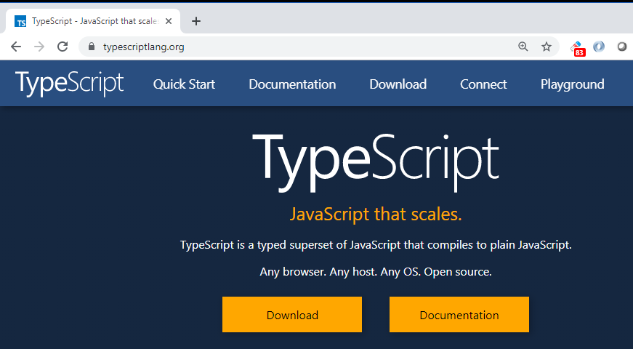

Slide 4



Slide 5


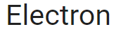











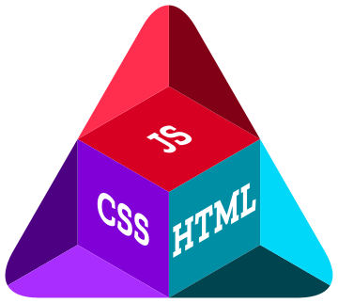
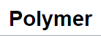


1995
JavaScript created by Netscape
2015
Mobile
Early 2000s
Client side Scripting for web
2005
Ajax, countless libraries
2009
Node.js
Server side scripting
2010
SPA
2013
Desktop

Slide 6
1995
JavaScript created by Netscape
2015
Mobile
Early 2000s
Client side Scripting for web
2005
Ajax, countless libraries
2009
Node.js
Server side scripting
2010
SPA
2013
Desktop

Slide 7
1995
JavaScript created by Netscape
2015
Mobile
Early 2000s
Client side Scripting for web
2005
Ajax, countless libraries
2009
Node.js
Server side scripting
2010
SPA
2013
Desktop

Slide 8
1995
JavaScript created by Netscape
2015
Mobile
Early 2000s
Client side Scripting for web
2005
Ajax, countless libraries
2009
Node.js
Server side scripting
2010
SPA
2013
Desktop

Slide 9
1995
JavaScript created by Netscape
2015
Mobile
Early 2000s
Client side Scripting for web
2005
Ajax, countless libraries
2009
Node.js
Server side scripting
2010
SPA
2013
Desktop

Slide 10
1995
JavaScript created by Netscape
2015
Mobile
Early 2000s
Client side Scripting for web
2005
Ajax, countless libraries
2009
Node.js
Server side scripting
2010
SPA
2013
Desktop

Slide 11
1995
JavaScript created by Netscape
2015
Mobile
Early 2000s
Client side Scripting for web
2005
Ajax, countless libraries
2009
Node.js
Server side scripting
2010
SPA
2013
Desktop

Slide 12



Cross Platform

Slide 13

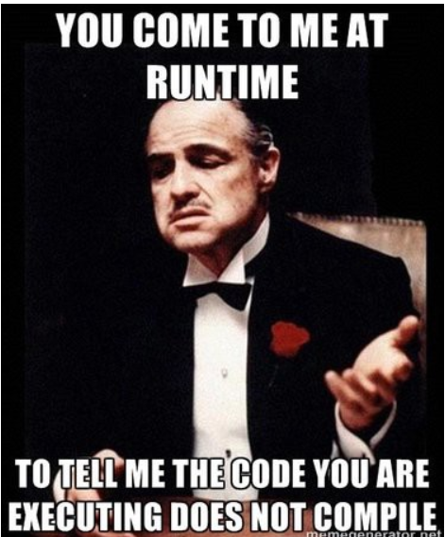
Dynamic Typing Good or Evil ?

Slide 14
JavaScript types and type errors
Boolean
Number / BigInt
String
Null / Undefined
object
function
cannot read property ‘xyz’ of null/undefined
xyz is undefined
abc is not a function

Slide 15
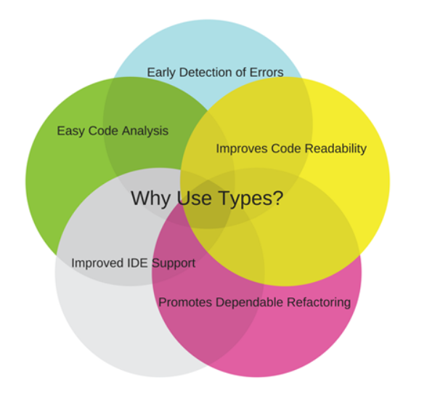


Slide 16
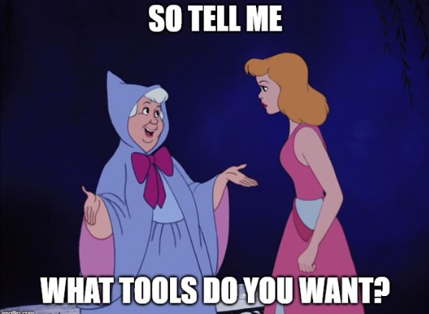
Tooling

Slide 17
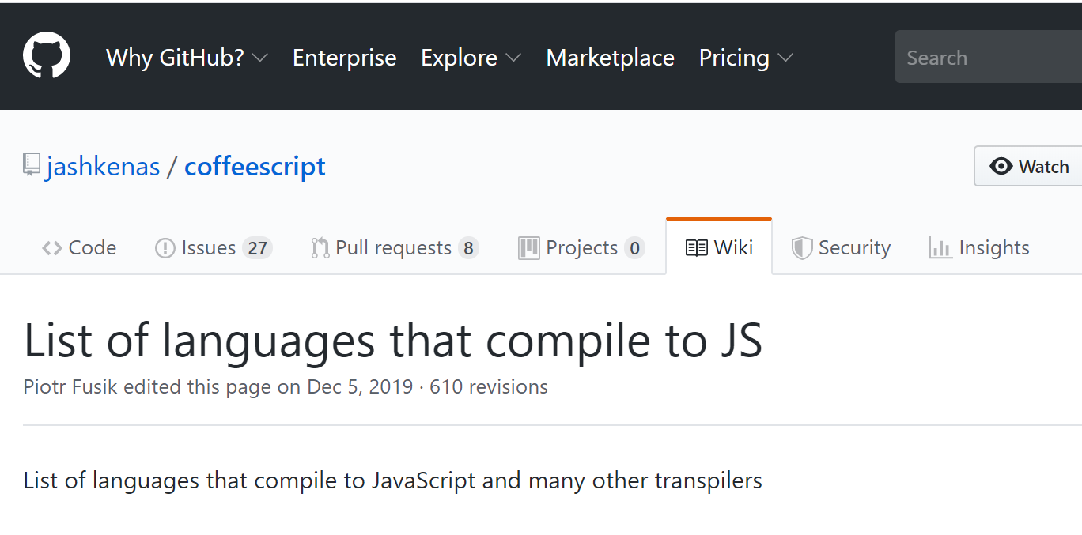
Languages that compile to JS
https://github.com/jashkenas/coffeescript/wiki/List-of-languages-that-compile-to-JS

Slide 18
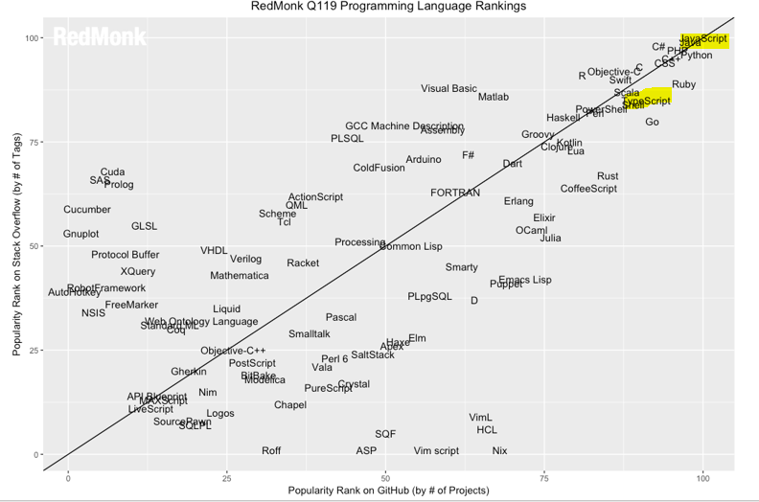

Slide 19
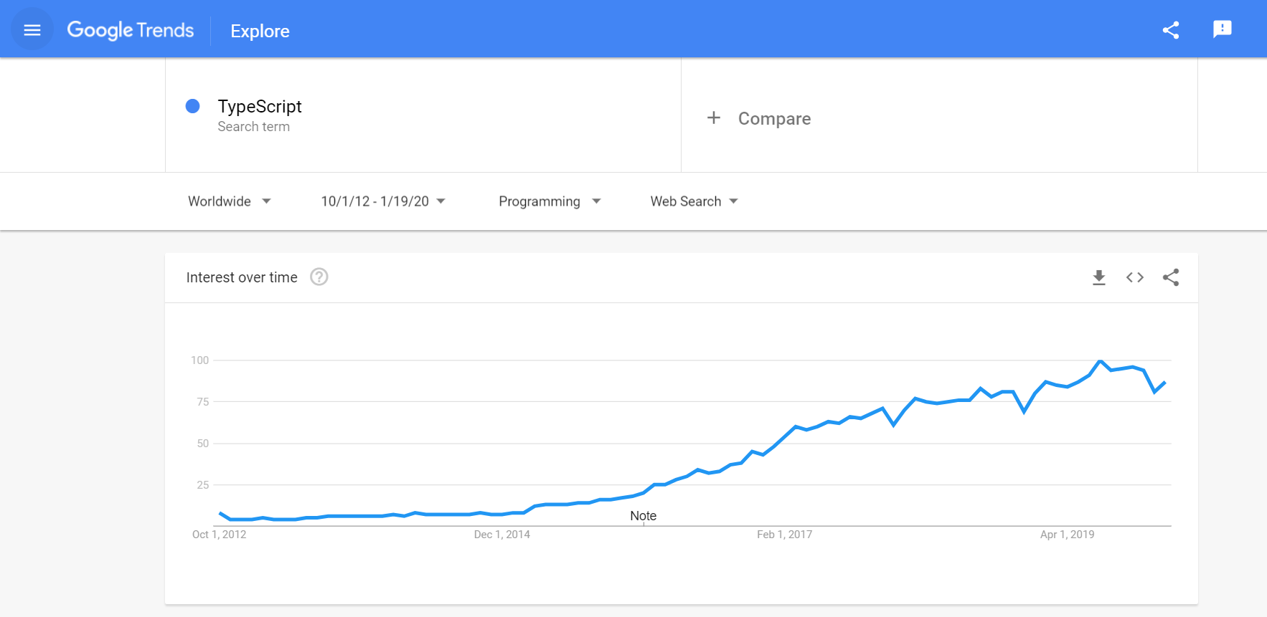

Slide 20
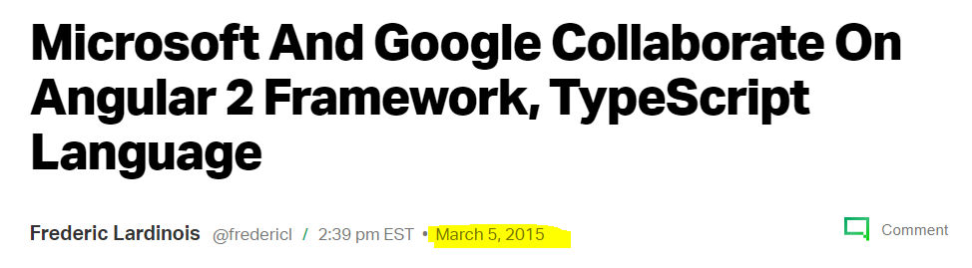

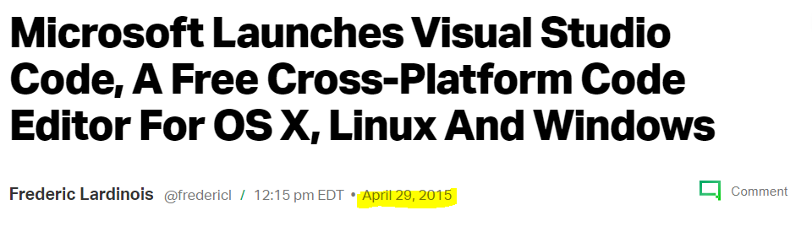

Slide 21
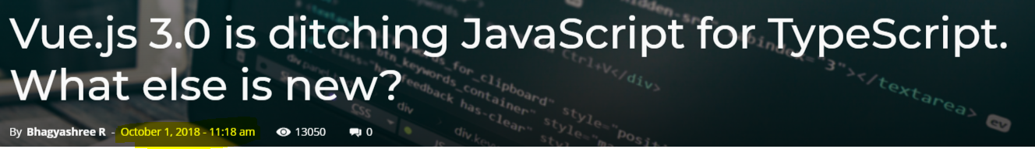
Oct 2018

Slide 22
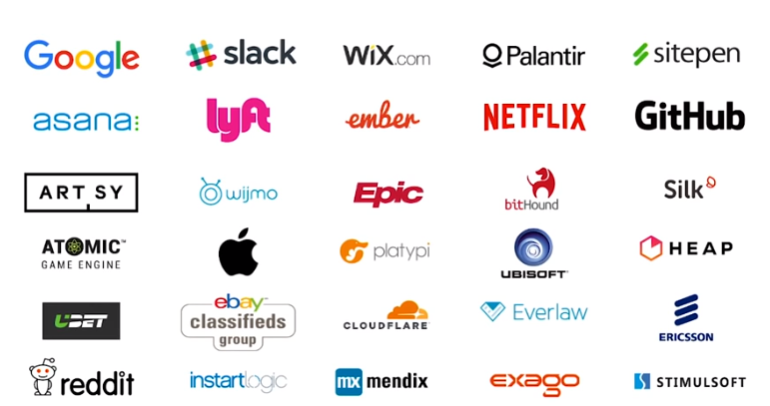

Slide 23

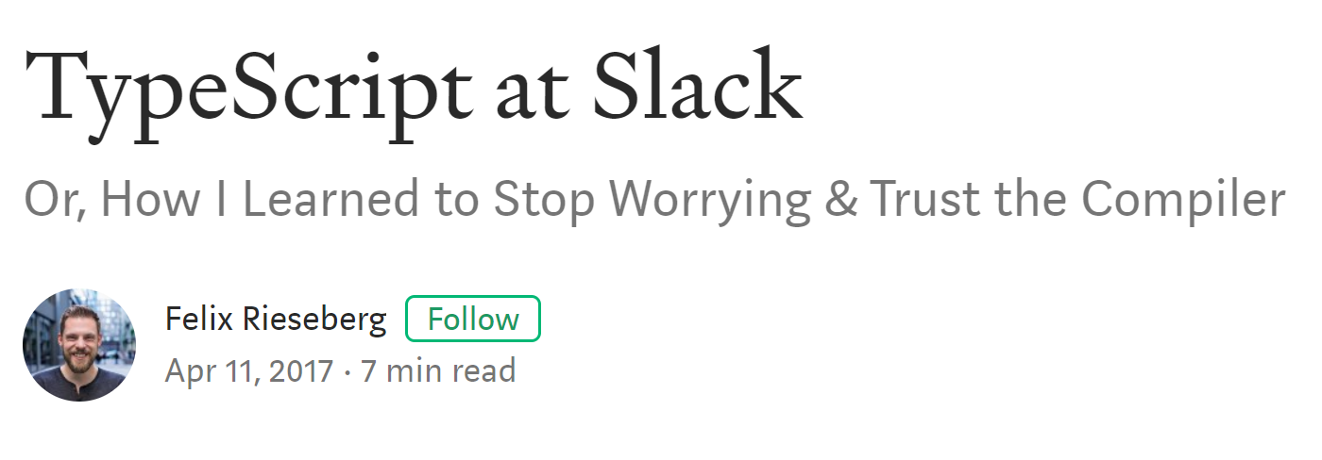

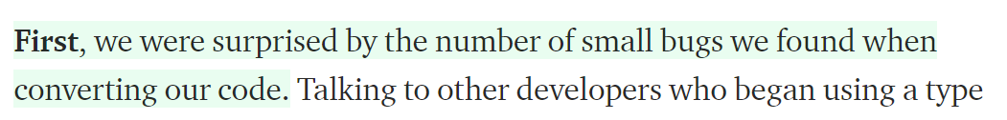

Slide 24
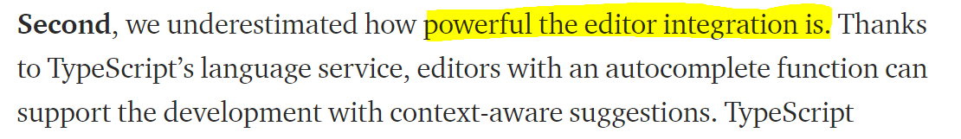

Slide 25
Future JS now
ES2015
ES2016
ES2017
ES2018
ES2019

Slide 26
TypeScript is
JavaScript that scales
Superset of JavaScript
Open Source and Open Development
Cross Platform Runs in any browser or host, any OS

Slide 27
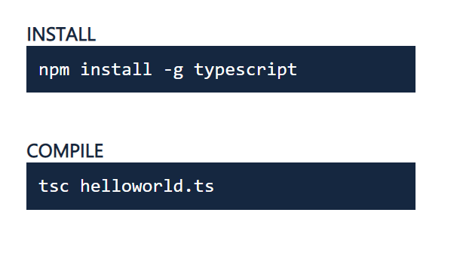
Current Version 3.8

Slide 28
Written in TypeScript
Compiler Options
tsconfig.json
tsc --init
Transpiles .ts -> .js
TypeScript Compiler

Slide 29

Type System
Like a dial
Optional
Erasable
Type errors don’t block JavaScript emit

Slide 30
Types
Basic
number
string
boolean
null
undefined
enum
Arrays
Tuples
any
void

Slide 31
Type System Features
Type Annotations
Type Inference
Union Types & Type Guards
Type Aliases

Slide 32
TypeScript Interface
Define a contract
Shape of the object
Extend multiple interfaces
Structural or “Duck” typing

Slide 33
Generics
Classes, Interfaces, Functions
Ability to abstract types
Type is now a variable
Create reusable components

Slide 34
New & Noteworthy
#private
Nullish coalescing
@ts-nocheck
Optional chaining

Slide 35
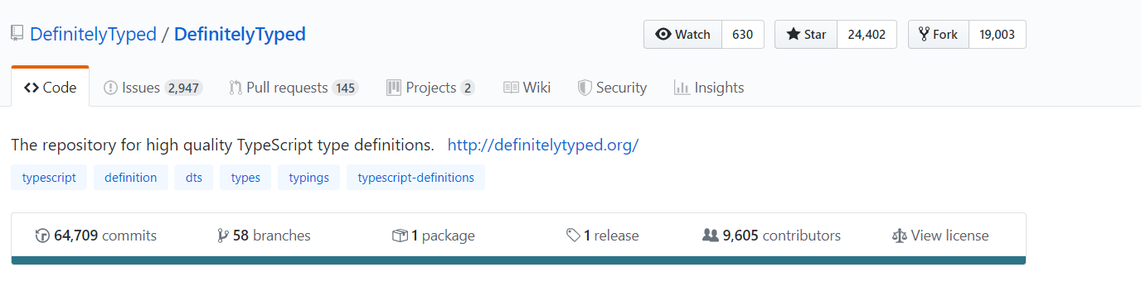
Definitely Typed Git Hub

Slide 36
Should I use TypeScript ?
Team skill-set
Are you working on a big team ?
Long-term refactoring needs
Is your project large / complex ?
Suggested by a library

Slide 37
TypeScript Learning Resources
TypeScript Playground
Basarat Ali Syed has a great Book on Github
Definitely Typed for Type Definitions
TalkScript (@TalkScript) podcast from sitepen
TypeScript Weekly (https://www.typescript-weekly.com/)

Slide 38
Thank You!
@NoriSangeeta
Code Samples : https://github.com/sangeetanori/TypeScript

